Slide 1
How generic is eternal inflation?
Ross Greenwood
Advancement to Candidacy

Slide 2
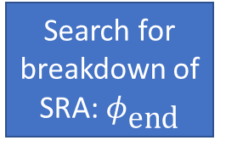
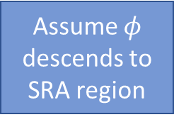
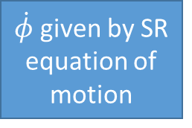
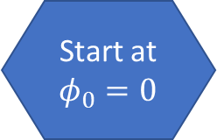
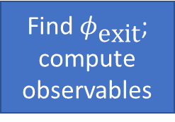

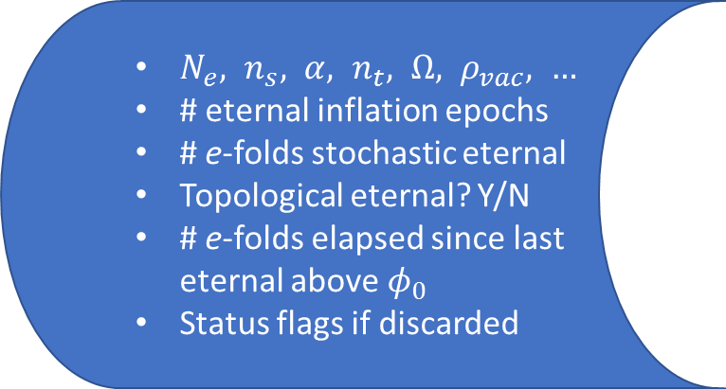
Generate potential as GRF
Look downhill for regions of valid SRA
Find any?
$N_{e}, n_{s}, α, n_{t}, Ω, ρ_{vac}, …$
# eternal inflation epochs
# e-folds stochastic eternal
Topological eternal? Y/N
# e-folds elapsed since last eternal above $φ_{0}$
Status flags if discarded
No
Yes
Start at $φ_{0}=0$
Is SRA valid?
Assume $φ$ descends to SRA region
Yes
$\dot{φ}$ given by SR equation of motion
Tunnel into adjacent basin
Look downhill to next local minimum
Check topological eternal
Fast tunneling
Check false-vac eternal
$ρ_{\text{vac}}$ big?
Search for breakdown of SRA: $φ_{\text{end}}$
55 e-folds?
Find $φ_{\text{exit}}$;
compute observables
Check stochastic eternal
Yes
No
Yes
Discard
SRA = Slow Roll Approximation

Slide 3

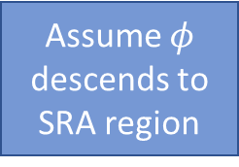
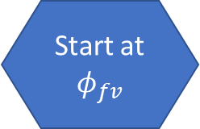


Overshoot
Start closer to $φ_{f}$
Assume $φ$ descends to SRA region
Integrate equations of motion
Result
Converge
Compute tunneling rate
Look downhill for regions of valid SRA
Start closer to $φ_{t}$
Tolerance
Start at $φ_{fv}$
Undershoot
Yes
No
Find any?
$\dot{φ}$ given by SR equation of motion
Check false-vac eternal
$ρ_{\text{vac}}$ big?
TWA valid?
Rescale potential

Slide 4

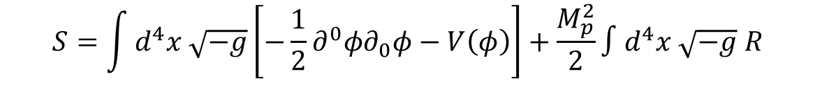


$$R=\frac{1}{N^{2}}\left(E^{ij}E_{ij}−E^{2}\right)$$
$$ds^{2}=−N^{2}dt^{2}+h_{ij}\left(dx^{i}+N^{i}dt\right)\left(dx^{j}+N^{j}dt\right)$$
$$\sqrt{−g}=Nh$$
$$E_{ij}={\dot{h}}_{ij}−N_{i;j}−N_{j;i}$$
$$S=\int{d^{4}x \sqrt{−g}\left[−\frac{1}{2}∂^{0}φ∂_{0}φ−V\left(φ\right)\right]+\frac{M_{p}^{2}}{2}∫d^{4}x \sqrt{−g} R}$$
$$S=\int{dt d^{3}x \sqrt{h} N \left[\frac{{\left(∂_{0}φ−N^{j}∂_{j}φ\right)}^{2}}{2N^{2}}−\frac{1}{2}∂^{i}{φ∂}_{i}φ−V\left(φ\right)\right]}+\frac{M_{p}^{2}}{2}\int{dt d^{3}x\frac{\sqrt{h}}{N}\left(E^{ij}E_{ij}−E^{2}\right)}$$

Slide 5
Potentially Observable
Eternal
vs

